Slide 1
ĐỒ ÁN CARO
Môn học: Cơ sở lập trình
GV hướng dẫn: TS. Trương Toàn Thịnh

Slide 2
Lớp: 24CTT3 (2024 – 2025)
Nhóm 1:
Ngô Viết Thanh Bình - 24120269
Đặng Bùi Thế Bảo – 24120261
Dương Nhựt Duy – 24120293
Ngô Mẫn Nhi – 24120250

Slide 3
CÁC TÍNH NĂNG GAME

Slide 4
Hàm code tiêu đề – chữ CARO to và đổi màu
#pragma once
#include <iostream>
#include <cstdlib>
#include <thread>
#include <chrono>
using namespace std;
string getC(int line) {
switch (line)
case 1: return " ***** “;
case 2: return " * ";
case 3: return "* ";
case 4: return "* ";
case 5: return " * ";
case 6: return " ***** ";
default: return "";
}
}
string getA(int line) {
switch (line) {
case 1: return " *** ";
case 2: return " * * ";
case 3: return "* * ";
case 4: return "******* ";
case 5: return "* * ";
case 6: return "* * ";
default: return "";
}
}
string getR(int line) {
switch (line) {
case 1: return " ****** ";
case 2: return " * * ";
case 3: return " * * ";
case 4: return " ****** ";
case 5: return " * * ";
case 6: return " * * ";
default: return "";
}
}
string getO(int line) {
switch (line) {
case 1: return " ***** ";
case 2: return " * * ";
case 3: return "* *";
case 4: return "* *";
case 5: return " * * ";
case 6: return " ***** ";
default: return "";
}
}
void setColor(int color) {
cout << "\033[" << color << "m";
}
void printCaro() {
for (int i = 1; i <= 6; i++) {
cout << getC(i) << " " << getA(i) << " " << getR(i) << " " << getO(i) << endl;
}
}
void Title() {
while (true) {
setColor(31);
system("cls");
printCaro();
std::this_thread::sleep_for(std::chrono::milliseconds(300));
setColor(32);
system("cls");
printCaro();
std::this_thread::sleep_for(std::chrono::milliseconds(300));
setColor(33);
system("cls");
printCaro();
std::this_thread::sleep_for(std::chrono::milliseconds(300));
}
setColor(0);
return;
}

Slide 5
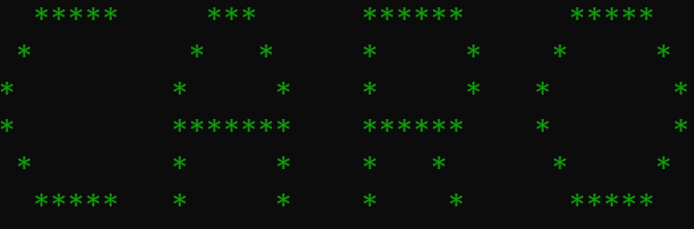
DEMO

Slide 6
Hàm code hiệu ứng chữ WIN đổi màu khi thắng
#pragma once
#include <iostream>
#include <cstdlib>
#include <thread>
#include <chrono
using namespace std;
void setColor(int color) {
cout << "\033[" << color << "m";
}
void printWin() {
cout << "W W IIIII N N" << endl;
cout << "W W I NN N" << endl;
cout << "W W W I N N N" << endl;
cout << "W W W W I N N N" << endl;
cout << "W W W W I N N N" << endl;
cout << "WW WW IIIII N N" << endl;
}
void win() {
while (true) {
setColor(31);
system("cls"); // Dùng "cls" nếu chạy trên Windows
printWin();
std::this_thread::sleep_for(std::chrono::milliseconds(300));
setColor(32);
system("cls");
printWin();
std::this_thread::sleep_for(std::chrono::milliseconds(300));
setColor(33);
system("cls");
printWin();
std::this_thread::sleep_for(std::chrono::milliseconds(300));
}
setColor(0);
return;
}

Slide 7
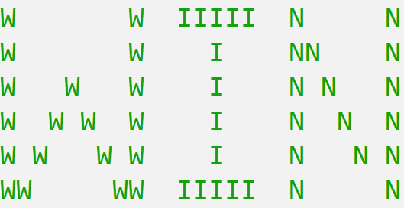
DEMO

Slide 8
Hàm code bảng menu
#include <iostream>
#include <conio.h>
#include <windows.h>
#include <string>
#include <thread>
#include <chrono>
using namespace std;
int x = 50;
int y = 5;
int box_spacing = 1;
void gotoXY(int x, int y) {
COORD coord;
coord.X = x;
coord.Y = y;
SetConsoleCursorPosition(GetStdHandle(STD_OUTPUT_HANDLE), coord);
}
void ShowCur(bool CursorVisibility) {
CONSOLE_CURSOR_INFO cursorInfo;
GetConsoleCursorInfo(GetStdHandle(STD_OUTPUT_HANDLE), &cursorInfo);
cursorInfo.bVisible = CursorVisibility; SetConsoleCursorInfo(GetStdHandle(STD_OUTPUT_HANDLE), &cursorInfo);
}
void SetColor(int color) {
SetConsoleTextAttribute(GetStdHandle(STD_OUTPUT_HANDLE), color);
}
void box(int x, int y, int w, int h, int t_color, int b_color, string nd) {
SetColor(b_color);
for (int iy = y + 1; iy <= y + h - 1; iy++) {
for (int ix = x + 1; ix <= x + w - 1; ix++) {
gotoXY(ix, iy);
cout << " ";
}
}
SetColor(7);
gotoXY(x + (w - nd.length()) / 2, y + h / 2);
cout << nd;
SetColor(t_color);
if (h <= 1 || w <= 1) return;
for (int ix = x; ix <= x + w; ix++) {
gotoXY(ix, y);
cout << char(196);
gotoXY(ix, y + h);
cout << char(196);
}
for (int iy = y; iy <= y + h; iy++) {
gotoXY(x, iy);
cout << char(179);
gotoXY(x + w, iy);
cout << char(179);
}
gotoXY(x, y); cout << char(218);
gotoXY(x + w, y); cout << char(191);
gotoXY(x, y + h); cout << char(192);
gotoXY(x + w, y + h); cout << char(217);
} void thanh_sang(int x, int y, int w, int h, int b_color_sang, string nd) {
SetColor(b_color_sang);
for (int iy = y + 1; iy <= y + h - 1; iy++) {
for (int ix = x + 1; ix <= x + w - 1; ix++) {
gotoXY(ix, iy);
cout << " ";
}
}

Slide 9
SetColor(7);
gotoXY(x + (w - nd.length()) / 2, y + h / 2);
cout << nd;
}
int menu() {
int w = 13;
int h = 2;
int t_color = 3;
int b_color = 1;
int b_color_sang = 75;
string items[] = { "New Game", "Load Game", "Setting", "Help", "Exit" };
int sl = 5;
for (int i = 0; i < sl; i++) {
box(x, y + i * (h + box_spacing), w, h, t_color, b_color, items[i]);
}
int xp = x;
int yp = y;
int xcu = xp;
int ycu = yp;
bool kt = true;
while (true) {
if (kt == true) {
gotoXY(xcu, ycu);
thanh_sang(xcu, ycu, w, h, b_color, items[(ycu - y) / (h + box_spacing)]);
xcu = xp;
ycu = yp;
thanh_sang(xp, yp, w, h, b_color_sang, items[(yp - y) / (h + box_spacing)]);
kt = false;
}
if (_kbhit()) {
_COMMAND = toupper(_getch());
kt = true;
if (_COMMAND == 'W') {if (yp != y)
yp -= (h + box_spacing);
else
yp = y + (h + box_spacing) * (sl - 1);
}
else if (_COMMAND == 'S') {
if (yp != y + (h + box_spacing) * (sl - 1))
yp += (h + box_spacing);
else
yp = y;
}
if (_COMMAND == 13) { // Enter
int index = (yp - y) / (h + box_spacing);
cout << "\nYou selected: " << items[index] << endl;
return index;
std::this_thread::sleep_for(std::chrono::milliseconds(1000)); // Tạm dừng 1 giây
break;
}
}
}
}

Slide 10
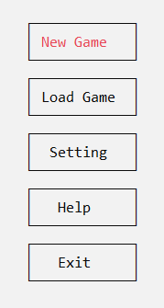
DEMO

Slide 11
Hàm code chức năng Help
#pragma once
#pragma once
#include <iostream>
#include <Windows.h>
#include <string>
using namespace std;
void ExitGame();
void StartGame();
void Play_Game();
void GotoXY(int x, int y);
void Box(int x, int y, int w, int h) {
if (h <= 1 || w <= 1) return;
for (int ix = x; ix <= x + w; ix++) {
GotoXY(ix, y);
cout << char(196);
GotoXY(ix, y + h);
cout << char(196);
}
for (int iy = y; iy <= y + h; iy++) {
GotoXY(x, iy);
cout << char(179);
GotoXY(x + w, iy);
cout << char(179);
}
GotoXY(x, y);
cout << char(218);
GotoXY(x + w, y);
cout << char(191);
GotoXY(x, h + y);
cout << char(192);
GotoXY(x + w, y + h);
cout << char(217);
}
void Help(int x, int y, int w, int h)
{
Box(x + 35, y, w, h);
GotoXY(x + 35 + 2, y + 2);
cout << "HUONG DAN THAO TAC VOI MENU:" << endl;
GotoXY(x + 35 + 2, y + 3);
cout << "+su dung phim W hoac S de lua chuc nang." << endl;
GotoXY(x + 35 + 2, y + 4);
cout << "+su dung phim enter de chon chuc nang.";
GotoXY(x + 35 + 2, y + 8);
cout << "HUONG DAN CHOI GAME:" << endl;
GotoXY(x + 35 + 2, y + 9);
cout << "+su dung cac phin A, W, S, D de lua vi tri dat quan." << endl;
GotoXY(x + 35 + 2, y + 10);
cout << "+su dung phim ENTER de dat quan." << endl;
GotoXY(x + 35 + 2, y + 11);
cout << "+ben nao cos duoc 5 quan lien tiep theo cac hang ngang, doc, cheo thi " << endl;
GotoXY(x + 35 + 2, y + 12);
cout << " se la nguoi chien thang." << endl;
while (1) {
_COMMAND = toupper(_getch());
if (_COMMAND == 27) { // 27 là mã của phím ESC
ExitGame();
}
}
system("pause");
}

Slide 12
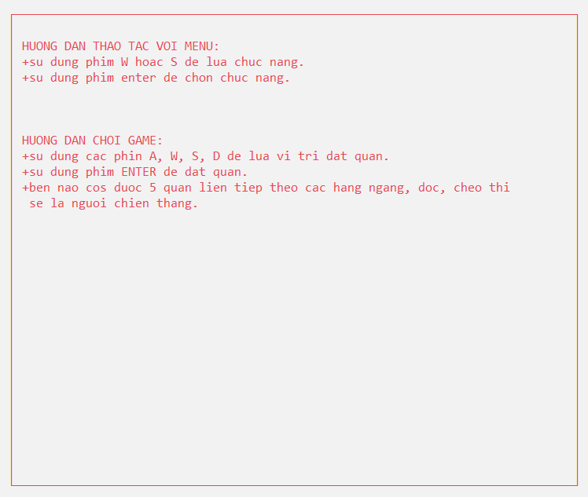
DEMO

Slide 13
Hàm code chức năng lưu/tải trò chơi
#pragma once
#include <iostream>
#include <string>
#include <fstream>
using namespace std;
void Save(_POINT _A[BOARD_SIZE][BOARD_SIZE], const Player& Player_1, const Player& Player_2, bool _TURN, const string& FileName) {
ofstream outputFile(FileName, ios::app);
if (!outputFile)
{
cerr << "Khong the mo File de ghi!" << endl;
return;
}
for(int j = 0; j < BOARD_SIZE; j++)
{
for (int i = 0; i < BOARD_SIZE;i++)
{
outputFile << _A[i][j].c << " ";
}
outputFile << endl;
}
outputFile << Player_1.Name << " " << Player_1.Moves << " " << Player_1.Wins << endl;
outputFile << Player_2.Name << " " << Player_2.Moves << " " << Player_2.Wins << endl;
outputFile << _TURN << endl;
outputFile.close();
}
void Load(_POINT _A[BOARD_SIZE][BOARD_SIZE], Player Player_1, Player Player_2, bool _TURN, const string& FileName)
{
ifstream inputFile(FileName);
if (!inputFile)
{
cerr << "Khong the mo File de doc!" << endl;
return;
}
for (int j = 0; j < BOARD_SIZE; j++)
{
for (int i = 0; i < BOARD_SIZE; i++)
{
inputFile >> _A[i][j].c;
}
inputFile >> Player_1.Name >> Player_1.Moves >> Player_1.Wins ;
inputFile >> Player_2.Name >> Player_2.Moves >> Player_2.Wins ;
inputFile >> _TURN;
inputFile.close();
}

Slide 14
Hàm code đánh dấu vị trí và chơi game
int CheckBoard(int pX, int pY) {
for (int i = 0; i < BOARD_SIZE; i++) {
for (int j = 0; j < BOARD_SIZE; j++) {
if (_A[i][j].x == pX && _A[i][j].y == pY && _A[i][j].c == 0) {
if (_TURN == true) _A[i][j].c = -1
else _A[i][j].c = 1; // Nếu lượt hiện hành là false thì c = 1
return _A[i][j].c;
}}}
return 0;}
void ResetData() {
for (int i = 0; i < BOARD_SIZE; i++) {
for (int j = 0; j < BOARD_SIZE; j++) {
_A[i][j].x = 4 * j + LEFT + 2;
_A[i][j].y = 2 * i + TOP + 1_A[i][j].c = 0;
}}
_TURN = true; _COMMAND = -1;
_X = _A[0][0].x; _Y = _A[0][0].y; }
void StartGame() {
system("cls");
ResetData(); DrawBoard(BOARD_SIZE); DrawBound(1, 1, 40, 150);
}
void GabageCollect()
{
}
void ExitGame() {
system("cls");
GabageCollect();}
void Play_Game()
{
bool validEnter = true;
Khoi_tao_Players(Player_1, Player_2, 2);
_flushall();
StartGame();
Show_Player(75, 7, 25, 4, 2);
while (1) {
_COMMAND = toupper(_getch());
if (_COMMAND == 27) {
ExitGame();
return;}
else {
if (_COMMAND == 'A') MoveLeft();
else if (_COMMAND == 'W') MoveUp();
else if (_COMMAND == 'S') MoveDown();
else if (_COMMAND == 'D') MoveRight();
else if (_COMMAND == 'M') menu();
else if (_COMMAND == 13) {
switch (CheckBoard(_X, _Y)) {
case -1:
printf("X");
Player_1.Moves++;
Show_Player(75, 7, 25, 4, 2);
break;
case 1:
printf("O");
Player_2.Moves++;
Show_Player(75, 7, 25, 4, 2);
break;
case 0:
validEnter = false;
break;
}
if (validEnter == true) {
switch (ProcessFinish(TestBoard())) {
case -1:
case 1:
case 0:
if (AskContinue() != 'Y') {
system("cls");
ExitGame();
}
else {
StartGame();
}}}
validEnter = true;
}}}}

Slide 15
Hàm vẽ bàn cờ
void GotoXY(int x, int y) {
COORD coord;
coord.X = x;
coord.Y = y;
SetConsoleCursorPosition(GetStdHandle(STD_OUTPUT_HANDLE), coord);
}
void DrawBoard(int pSize)
{
for (int ix = LEFT + 1; ix <= LEFT + pSize * 4 - 1; ix += 4)
{
for (int iy = TOP; iy <= TOP + pSize * 2; iy += 2)
{
GotoXY(ix, iy);
cout << char(196);
GotoXY(ix + 1, iy);
cout << char(196);
GotoXY(ix + 2, iy);
cout << char(196);
}
}
for (int iy = TOP + 1; iy <= TOP + pSize * 2 - 1; iy += 2)
{
for (int ix = LEFT; ix <= LEFT + pSize * 4; ix += 4)
{
GotoXY(ix, iy);
cout << char(179);
}
}
for (int ix = LEFT + 4; ix <= LEFT + pSize * 4; ix += 4)
{
for (int iy = TOP + 2; iy <= TOP + pSize * 2 - 2; iy += 2)
{
GotoXY(ix, iy);
cout << char(197);
}
}
for (int ix = LEFT + 4; ix <= LEFT + pSize * 4; ix += 4)
{
GotoXY(ix, TOP);
cout << char(194);
GotoXY(ix, TOP + pSize * 2);
cout << char(193);
}
for (int iy = TOP + 2; iy <= TOP + pSize * 2; iy += 2)
{
GotoXY(LEFT, iy);
cout << char(195);
GotoXY(LEFT + pSize * 4, iy);
cout << char(180);
}
GotoXY(LEFT, TOP);
cout << char(218);
GotoXY(pSize * 4 + LEFT, TOP);
cout << char(191);
GotoXY(LEFT, TOP + pSize * 2);
cout << char(192);
GotoXY(LEFT + pSize * 4, TOP + pSize * 2);
cout << char(217);
}
int AskContinue() {
Box(75, _A[BOARD_SIZE - 1][BOARD_SIZE - 1].y - 20, 70, 6);
GotoXY(85 + 10, _A[BOARD_SIZE - 1][BOARD_SIZE - 1].y - 18);
printf("Nhan 'y/n' de tiep tuc/dung: ");
return toupper(_getch());
}

Slide 16
void DrawBound(int x0, int y0, int h, int w)
{
for (int ix = x0 + 1; ix < x0 + w; ix++)
{
GotoXY(ix, y0);
cout << char(196);
GotoXY(ix, y0 + h);
cout << char(196);
}
for (int iy = x0 + 1; iy < y0 + h; iy++)
{
GotoXY(x0, iy);
cout << char(179);
GotoXY(x0 + w, iy);
cout << char(179);
}
GotoXY(x0, y0); cout << char(218);
GotoXY(x0 + w, y0); cout << char(191);
GotoXY(x0, y0 + h); cout << char(192);
GotoXY(x0 + w, y0 + h); cout << char(217);
}
void MoveRight() {
if (_X < _A[BOARD_SIZE - 1][BOARD_SIZE - 1].x)
{
_X += 4;
GotoXY(_X, _Y);
}
}
void MoveLeft() {
if (_X > _A[0][0].x) {
_X -= 4;
GotoXY(_X, _Y);
}
}
void MoveDown() {
if (_Y < _A[BOARD_SIZE - 1][BOARD_SIZE - 1].y)
{
_Y += 2;
GotoXY(_X, _Y);
}
}
void MoveUp() {
if (_Y > _A[0][0].y) {
_Y -= 2;
GotoXY(_X, _Y);
}
}
bool isDraw() {
for (int i = 0; i < BOARD_SIZE; i++) {
for (int j = 0; j < BOARD_SIZE; j++) {
if (_A[i][j].c == 0)
return false;
}
}
return true;
}

Slide 17
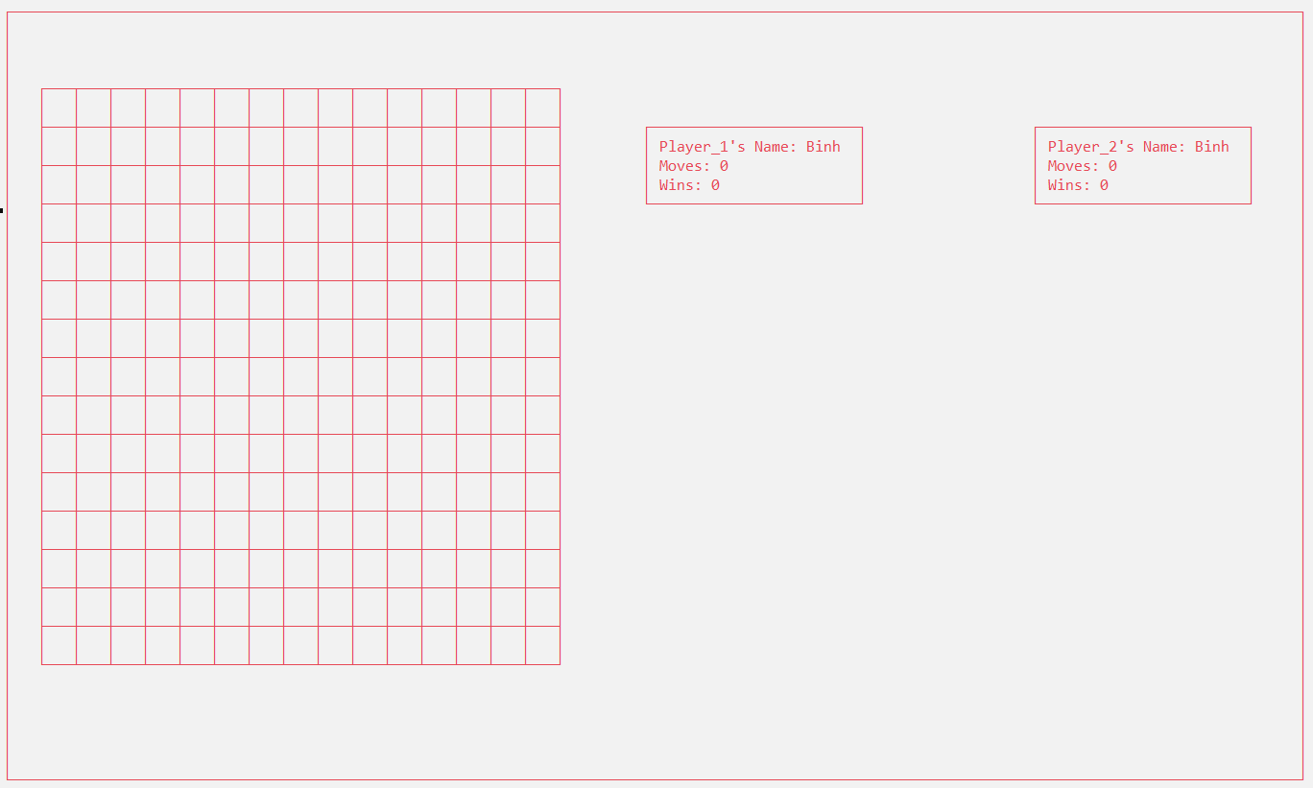
DEMO

Slide 18
Hàm code nhập thông số người chơi
struct Player {
string Name;
int Moves = 0;
int Wins = 0;
void Thong_so_Players(int n)
{
cout << endl << "Nhap thong tin Players: " << endl;
cout << "Name of Player_" << n << ": ";
getline(cin, Name);
}
void In_thong_so_Player(int n)
{
cout << "Player_" << n << "'s Name: " << Name << endl;
}
void So_buoc_di_chuyen() {
cout << "Moves: " << Moves << endl;
}
void So_lan_thang() {
cout << "Wins: " << Wins << endl;
}
};
Player Player_1;
Player Player_2;
void Khoi_tao_Players(Player& Player_1, Player& Player_2, int n)
{
if (n == 1)
{
Player_1.Thong_so_Players(1);
}
else if (n == 2)
{
Player_1.Thong_so_Players(1);
Player_2.Thong_so_Players(2);
}
}
void Show_Player(int x, int y, int w, int h, int number_of_players)
{
{
if (number_of_players == 1)
{
Box(x, y, w, h);
GotoXY(x + 2, y + 1);
Player_1.In_thong_so_Player(1);
GotoXY(x + 2, y + 2);
Player_1.So_buoc_di_chuyen();
GotoXY(x + 2, y + 3);
Player_1.So_lan_thang();
}
else if (number_of_players == 2)
{
Box(x, y, w, h);
GotoXY(x + 2, y + 1);
Player_1.In_thong_so_Player(1);
GotoXY(x + 2, y + 2);
Player_1.So_buoc_di_chuyen();
GotoXY(x + 2, y + 3);
Player_1.So_lan_thang();
Box(x + 45, y, w, h);
GotoXY(x + 45 + 2, y + 1);
Player_2.In_thong_so_Player(2);
GotoXY(x + 45 + 2, y + 2);
Player_2.So_buoc_di_chuyen();
GotoXY(x + 45 + 2, y + 3);
Player_2.So_lan_thang();
}
}
}

Slide 19
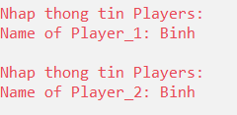

DEMO

Slide 20
Hàm code xử lý hiệu ứng thắng, thua, hòa
int ProcessFinish(int pWhoWin) {
GotoXY(85 + 2, _A[BOARD_SIZE - 1][BOARD_SIZE - 1].y - 8);
switch (pWhoWin) {
case -1:
Box(75, _A[BOARD_SIZE - 1][BOARD_SIZE - 1].y - 10, 70, 10);
GotoXY(85 + 10, _A[BOARD_SIZE - 1][BOARD_SIZE - 1].y - 5);
cout << "Player_1: " << Player_1.Name << " THANG" << " Player_2: " << Player_2.Name << endl;
break;
case 1:
Box(75, _A[BOARD_SIZE - 1][BOARD_SIZE - 1].y - 10, 70, 10);
GotoXY(85 + 10, _A[BOARD_SIZE - 1][BOARD_SIZE - 1].y - 5);
cout << "Player_2: " << Player_2.Name << " THANG" << " Player_1: " << Player_1.Name << endl;
break;
case 0:
Box(75, _A[BOARD_SIZE - 1][BOARD_SIZE - 1].y - 10, 70, 10);
GotoXY(85 + 10, _A[BOARD_SIZE - 1][BOARD_SIZE - 1].y - 5);
cout << "Player_1: " << Player_1.Name << " HOA" << " Player_2: " << Player_2.Name << endl;
break;
case 2:
_TURN = !_TURN;
}
GotoXY(_X, _Y);
return pWhoWin;
}
bool checkWin(int x, int y) {
int player = _A[x][y].c;
int dem_1 = 0;
int dem_2 = 0;
int dem_3 = 0;
int dem_4 = 0;
for (int j = y; j < y + 5; j++)
{
if (_A[x][j].c == player) dem_1++;
}
for (int i = x; i < x + 5; i++)
{
if (_A[i][y].c == player) dem_2++;
}
for (int k = 0; k < 5; k++)
{
if (_A[k + x][k + y].c == player) dem_3++;
}
for (int k = 0; k < 5; k++)
{
if (_A[x - k][k + y].c == player) dem_4++;
}
if (dem_1 >= 5 || dem_2 >= 5 || dem_3 >= 5 || dem_4 >= 5) {
return true;
return false;}
int TestBoard() {
if (isDraw()) {
return 0;}
for (int i = 0; i < BOARD_SIZE; i++) {
for (int j = 0; j < BOARD_SIZE; j++) {
if (_A[i][j].c != 0 && checkWin(i, j)) {
if (_TURN == true) {
Player_1.Wins++;
return -1;
}
else {
Player_2.Wins++;
return 1;
}}}
return 2;
}

Slide 21
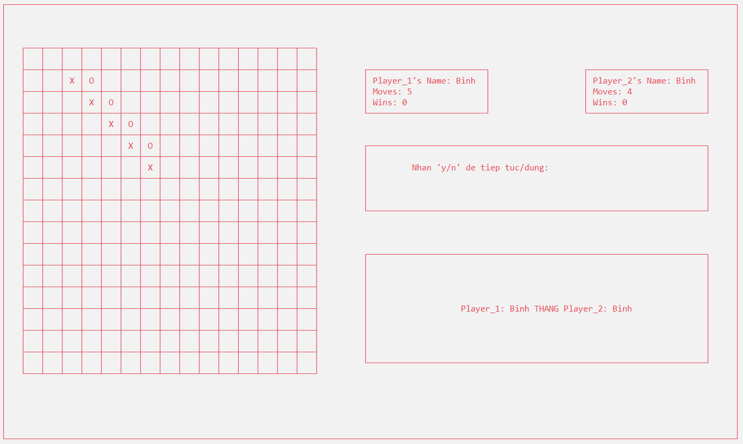
DEMO

Slide 22
Cảm ơn thầy đã chú ý đón xem

